Slide 1

Python for
Machine Learning
Nisal Mihiranga

Slide 2


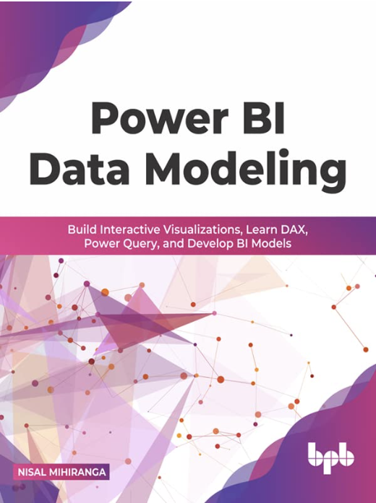
Facilitator
Nisal Mihiranga
Areas of Interest & Expertise:
AI, Technology, Science, Teaching, Consulting, Mentoring
Experience:
Head of AI and Data Science, Architect at
Zone24x7 pvt Ltd
Corporate Trainer
12 Years of Industry exposure to Data Engineering, Data Science and Business Intelligence
Credentials:
M.Sc in Data Science
B.Sc in Information Technology
Microsoft Certified Trainer

Slide 3
About You ?
Your Name?
Where are you from ?
Your Hobby ?
What do you do currently ?
What do you like to do in next five years

Slide 4
Curriculum
Week | Module
Week 1 | Python for Machine Learning
Week 2 | Introduction to Machine Learning
Week 3 | Data Transformation and Analysis
Week 4 | Regression Analysis
Week 5 | Classification, KNN, DT, SVM, Ensemble Systems
Week 6 | Clustering Algorithms
Week 7 | Neural Networks
Week 8 | MLOPS, Machine Learning in Cloud

Slide 5
Agenda
Week | 1st Week
Day | 31th of Sep
Duration | 4hrs
TIME | TOPIC & ACTIVITY | COMPLETED-
30 Mins | Intro to Python | Yes
60 Mins | Variables and Data types | Yes
30 Mins | Data Structures | Yes
20 Mins | Break
45 Mins | Operators, Conditional programing | Yes
30 Mins | Loops | Yes
20 Mins | Envionments | Yes
5 Mins | Q&A Session on lesson learn | Yes

Slide 6
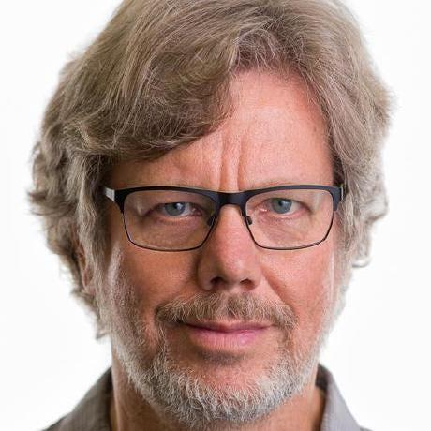
Introduction to Python
Python is a high-level, general-purpose programming language known for its simplicity and readability. It was created by Guido van Rossum and released in 1991.
Because of its emphasis on code readability and a simple syntax, Python is a great language for both inexperienced and seasoned developers.

Slide 7
Python Can Do ..
Server-side development (web)
Software application development
Mathematical and scientific computation
System scripting and automation

Slide 8
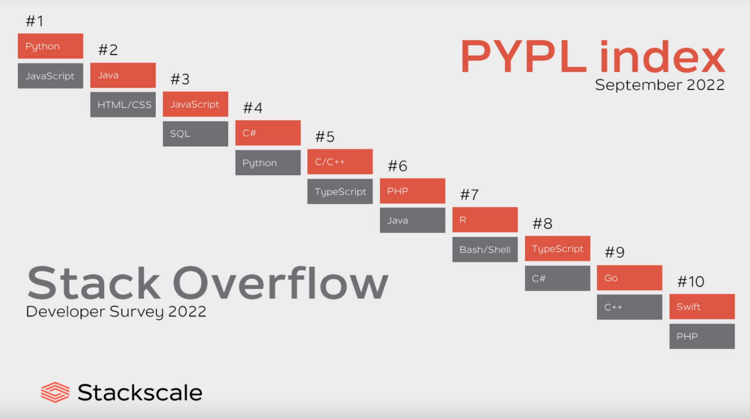

Slide 9
Why Python is popular?
Python is platform agnostic(Runs on Windows, MacOS, Linux, Raspberry Pi)
Its an English like language that follow simple syntax
Fewer lines of code when compare to other programming languages like Java, C++
Runs on an interpreter, code can be executed as soon as it is written
Can be treated as procedural and functional way

Slide 10
Python execution
Source Code
Python
Interpreter
Compiler
Bytecode
Input
Python Virtual Machine
Library
Modules
Code get executed

Slide 11
The role of indentation in Python
In Python, indentation plays a crucial role in determining the structure and organization of code blocks. Unlike many other programming languages that use braces or keywords to denote code blocks, Python uses indentation to indicate the grouping and hierarchy of statements within a program.
If the indentation is not correct, you will get an error!
Don’t worry, most of the modern IDE supports auto indentation

Slide 12


3 Options to Start Python Journey
Install Python and manage the libraries by your own, code with an IDE
Install package manager like Anaconda
Cloud environment such as Google colab

Slide 13
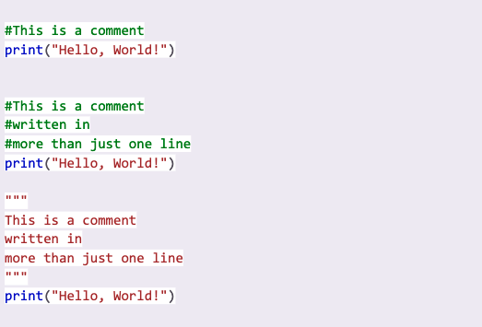
Comments in Python
Comments can be used to explain your code and make it more human readable. It also helpful to prevent executing your code sections when you testing

Slide 14
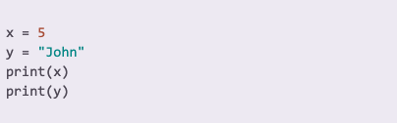
Variables in Python
The variables are the containers storing data values in Python.

Slide 15
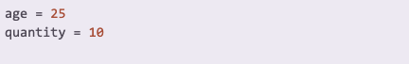
Data Types: Integer
Hold the numerical values

Slide 16
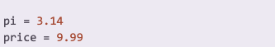
Data Types: Float
A data type that represents decimal numbers with a fractional part

Slide 17
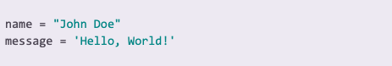
Data Types: String
A data type that represents a sequence of characters, such as letters, numbers, and symbols

Slide 18
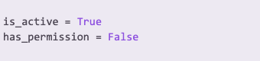
Data Types: Boolean
A data type that represents a logical value, either True or False.

Slide 19
Classroom Activity
15 mins
Notes:
Game of noughts and crosses (tic-tac-toe) How we played and enjoyed
Setup with 3x3 squares.
One player used 'X' and the other used 'O'.
The goal was to be the first to get three of your marks in a row, either horizontally, vertically, or diagonally.
The first player to get three of their marks in a row (horizontally, vertically, or diagonally) wins the game.
If all nine squares are filled and no player has three marks in a row, the game ends in a draw.
Today you need to play with set of Instructions.
Two volunteers are needed: one to play for the humans and another to follow the instructions given by the intelligent piece of paper.

Slide 20
Data Structures

Slide 21
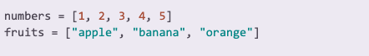
Data Types: List
A data type that represents an ordered collection of elements, which can be of different data types.

Slide 22
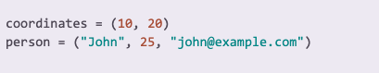
Data Types: Tuple
A data type that represents an ordered and immutable collection of elements, which can be of different data types.

Slide 23
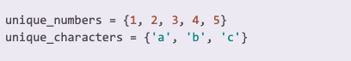
Data Types: Set
A data type that represents an unordered collection of unique elements, ensuring no duplicates.

Slide 24
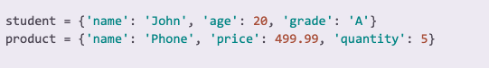
Data Types: Dictionary
A data type that represents a collection of key-value pairs, allowing efficient lookup and retrieval of values based on keys.

Slide 25
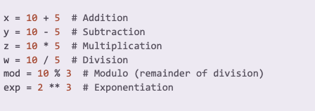
Arithmetic Operators
Arithmetic Operators: Operators used to perform mathematical calculations, such as addition (+), subtraction (-), multiplication (*), division (/), modulo (%), and exponentiation (**).

Slide 26
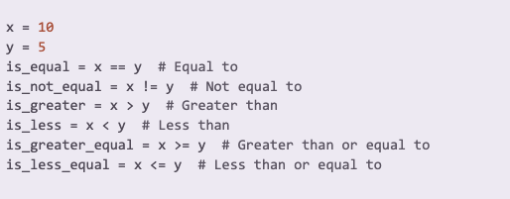
Comparison Operators
Operators used to compare values and evaluate conditions, such as equal to (==), not equal to (!=), greater than (>), less than (<), greater than or equal to (>=), and less than or equal to (<=).

Slide 27
20 mins Break

Slide 28
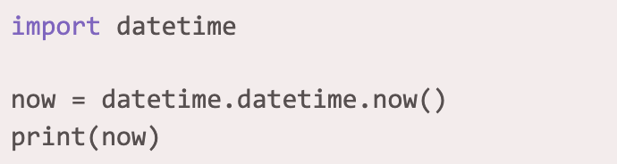
Date Time in Python
In python there are multiple ways of work with Date and Time. However, Date or Time is not a default data type in python. But we can import the module DateTime to work with dates
Output
2023-08-11 00:55:07.966413
Year
Month
Day
Hour
Min
Sec
Microseconds

Slide 29
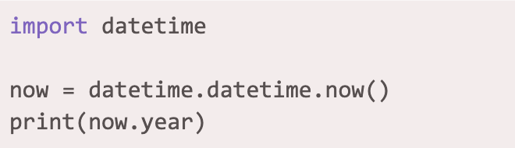
Get the current year in Python
You can extract Individual components
Return the year from current date time
2023-08-11 00:55:07.966413
Year
Month
Day
Hour
Min
Sec
Microseconds

Slide 30
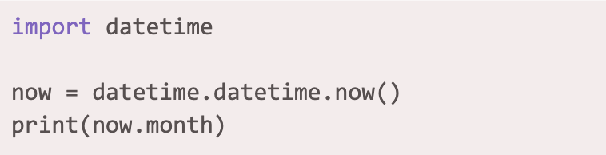
Get the current Month in Python
You can extract Individual components
Return the month from current date time
2023-08-11 00:55:07.966413
Year
Month
Day
Hour
Min
Sec
Microseconds

Slide 31
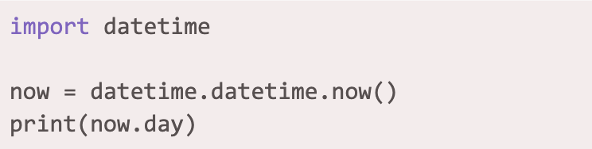
Get the current Day in Python
You can extract Individual components
Return the day from current date time
2023-08-11 00:55:07.966413
Year
Month
Day
Hour
Min
Sec
Microseconds

Slide 32
Get the current year in Python
You can extract Individual components
Return the year from current date time
2023-08-11 00:55:07.966413
Year
Month
Day
Hour
Min
Sec
Microseconds

Slide 33
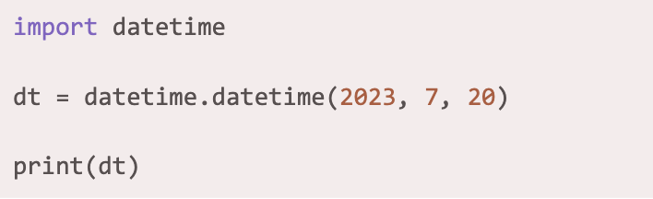
Creating a Date
You can use datetime() class to create the datetime object which requires three parameters.

Slide 34
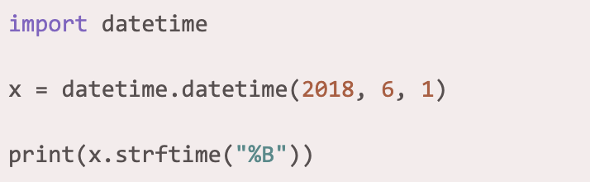
Format the Output Date
The return of the datetime can be formatted using strftime() method. The output date can format into readable string

Slide 35
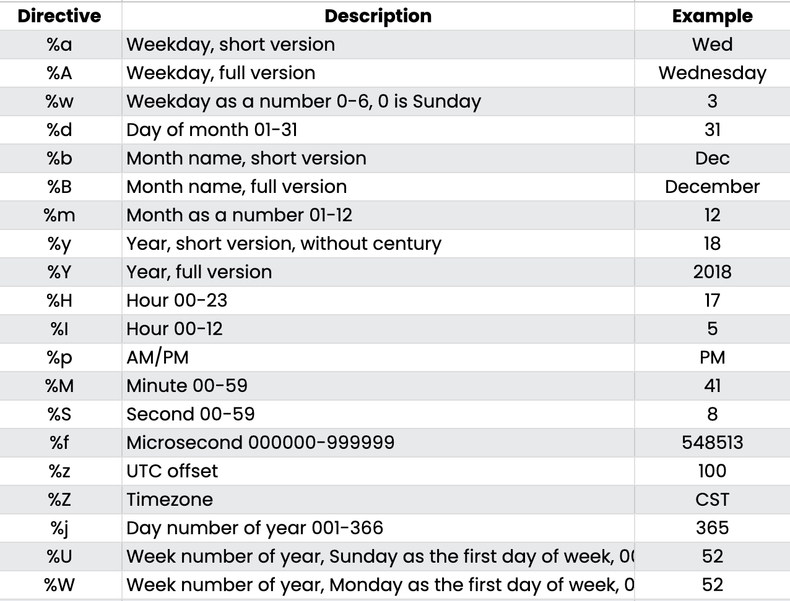
Format the Output Date cont.

Slide 36
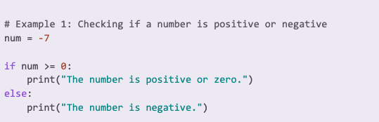
If and Else Statement
In Python, the "if-else" conditional statement allows you to perform different actions based on a condition being true or false.
Exercise: Checking if a person is eligible to vote
Notes:
age = 17 if age >= 18: print("You are eligible to vote.") else: print("You are not eligible to vote yet.")

Slide 37
Classroom Activity
15 mins
Create a calculator

Slide 38
Repetition Statements

Slide 39
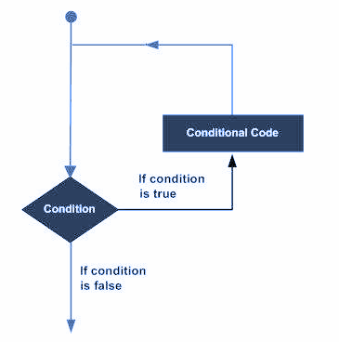
Python Loops
A loop statement allows us to execute a statement or group of statements multiple times.

Slide 40
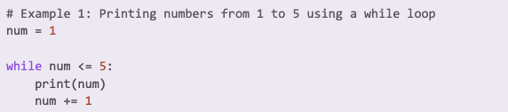
While Loop
In Python, the "while" loop is used to repeatedly execute a block of code as long as a certain condition remains true.
Exercise: Calculating the sum of numbers from 1 to 10 using a while loop
Notes:
# Example 2: Calculating the sum of numbers from 1 to 10 using a while loop
total = 0
num = 1
while num <= 10:
total += num
num += 1
print("The sum of numbers from 1 to 10 is:", total)

Slide 41
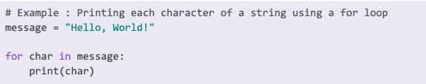
For Loop
In Python, the "for" loop is used to iterate over a sequence (such as a list, tuple, or string) or any iterable object, executing a block of code for each element in the sequence.
Exercise: Iterating over a list and performing a repetitive task using a for loop
Notes:
Iterating over a list and performing a repetitive task using a for loop
numbers = [1, 2, 3, 4, 5]
for num in numbers:
square = num ** 2
print("Square of", num, "is", square)

Slide 42
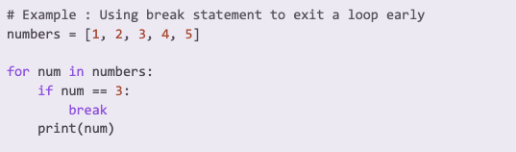
Loop Control Statements
In Python, for loop control statements "break" allow you to alter the flow of execution within a for loop.

Slide 43
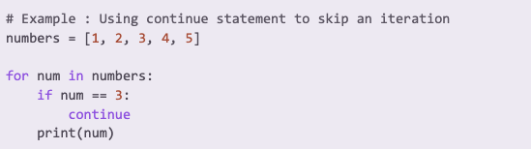
Loop Control Statements
In Python, for loop control statements "continue" allow you to alter the flow of execution within a for loop.

Slide 44
Q&A

Slide 45
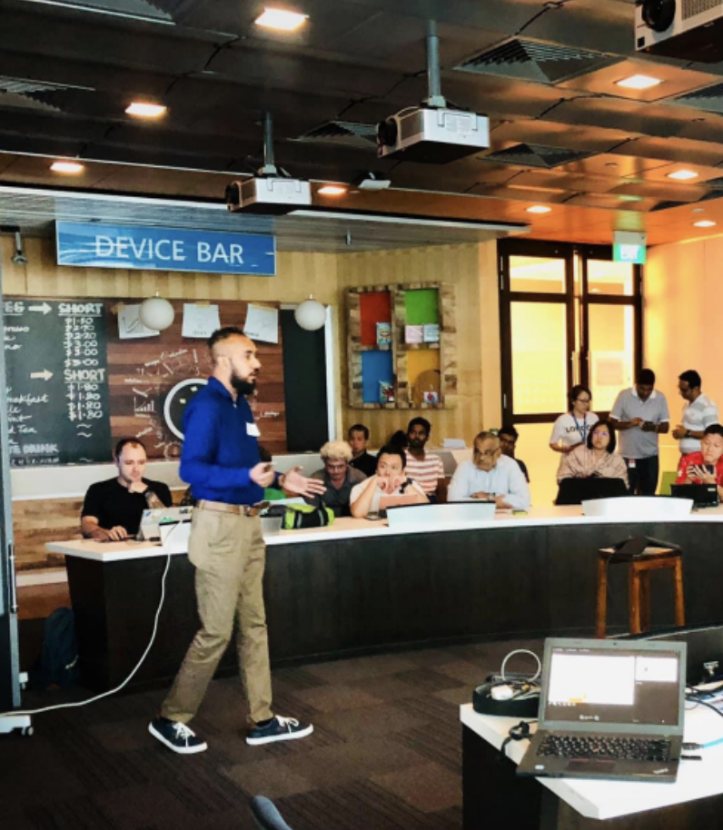




Thank You
Nisal Mihiranga
Head of AI & DS at Zone24x7
Consultant, Trainer
M: +94 71 726 3044

